Slide 1
GREEN HOUSE MONITORING & CONTROLLING
By,
G CHETHANA
G RAJ KUMAR CH SIRIVANTH D VENKATESH

Slide 2
ABSTRACT
The objective of this project is to design a simple, easy to install, microcontroller-based circuit to monitor and record the values of temperature, humidity, soil moisture and sunlight of the natural environment that are continuously modified and controlled in order optimize them to achieve maximum plant growth and yield.

Slide 3
BASE FOR THE PROJECT
We have used a LPC2103 IC which can perform millions of operations in a millisecond. It is quick, consumes less power and cost efficient.
We have used GSM module instead of ZigBee technology because it has the limitations of short range, low complexity, and low data speed.

Slide 4
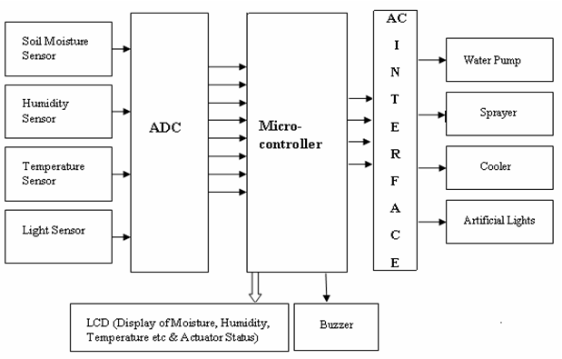
BLOCK DIAGRAM:
GSM

Slide 5
HARDWARE COMPONENTS FOR IMPLEMENTATION OF THE FUNCTION MODULE
CONTROLLER (ARM LPC 2103).
GSM MODULES.
SOILSENSOR.
TEMPERATURE SENSOR.
HUMIDITY SENSOR.
RELAY DRIVER CIRCUIT
POWER SUPPLY UNIT
MAX 232 IC.
MISCELLINOIUS COMPONENTS.

Slide 6
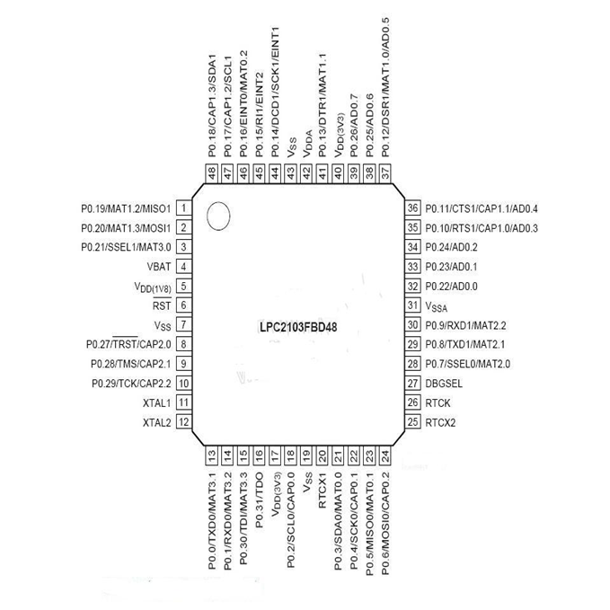
ARM PROCESSOR PIN DIAGRAM:

Slide 7
FEATURES OF LPC2103
16-bit/32-bit ARM7TDMI-S microcontroller in a tiny LQFP48 package.
It has 2 serial ports and power consumption is only 3.3V
It has both Vonnewmann and Harward architecture
Low power Real-Time Clock (RTC) with independent power and dedicated 32 kHz clock input.
Power saving modes include Idle mode, Power-down mode with RTC active, and Power-down mode.

Slide 8
LPC2103 FEATURES:
It has 8kb to 32kb RAM and 32kb to 50kb ROM
It has 16 interrupts
It works on RISC processing

Slide 9
TEMPERATURE SENSOR:
The LM35/LM34 has an output of 10 mV/°F with a typical nonlinearity of only ±0.35°F over a −50 to +300°F temperature range, and is accurate to within ±0.4°F typically at room temperature (77°F).
Low cost and high accuracy are maintained by performing trimming and calibration procedures at the wafer level.
With less than 70 μA of current drain, the LM34 sensor has very little self-heating

Slide 10

LDR SENSOR:
A light dependent resistor works on the principle of photo conductivity. Photo conductivity is an optical phenomenon in which the materials conductivity is increased when light is absorbed by the material.

Slide 11
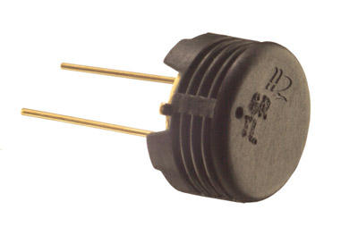
HUMIDITY SENSORS:
Humidity sensors are employed to provide an indication of the moisture levels in the environment.
Most humidity sensors are relative humidity sensors.

Slide 12
Soil Sensors:
Soil moisture sensors measure the volumetric water content in soil.
Measuring soil moisture is important for agricultural applications to help farmers manage their irrigation systems more efficiently. Knowing the exact soil moisture conditions on their fields, not only are farmers able to generally use less water to grow a crop, they are also able to increase yields and the quality of the crop by improved management of soil moisture during critical plant growth stages.

Slide 13
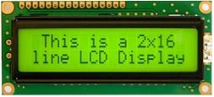
LCD DISPLAY:
Liquid Crystal Display also called as LCD is very helpful in providing user interface as well as for debugging purpose
Whereas D0 to D7th bit is the Data lines, RS, RW and EN pins are the control pins and remaining pins are +5V, -5V and GND to provide supply.

Slide 14

Power Supply

Slide 15
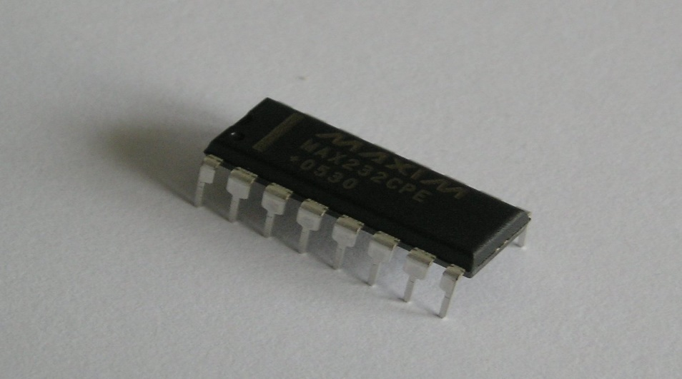
MAX232
Standard serial interfacing of microcontroller (TTL) with PC or any RS232C Standard device , requires TTL to RS232 Level converter . A MAX232 is used for this purpose. It provides 2-channel RS232C port and requires external 10uF capacitors.

Slide 16
GSM Module:
Global System for Mobile Communication is a open digital cellular technology used to transmit mobile voice and data service at a speed of 9.6kbits together with the transmission on messages.

Slide 17
SOFTWARE COMPONENTS FOR IMPLEMENTATION OF THE FUNCTION MODULE
FOR LPC 2031 BASED:
The KEIL MDK-ARM is a complete software development environment for ARM7 (LPC 2031) and ARM7 processor-based devices.
Flash the device using FLASH MAGIC, a free software utility sponsored by NXP.

Slide 18
LANGUAGE:
All editions provide a complete Embedded C/C++ development environment and KEIL includes extensive middleware libraries.

Slide 19
PLATFORM:
Windows XP
Windows XP (stylised as Windows^{xp}; codenamed Whistler) is a personal computer operating system that was produced by Microsoft as part of the Windows NT family of operating systems.
Windows XP was originally bundled with Internet Explorer 6, Outlook Express 6, Windows Messenger, and MSN Explorer.

Slide 20
ADVANTAGES:
1. This makes the proposed system to be an economical, portable and a low maintenance solution for greenhouse applications,
2. especially in rural areas and for small scale agriculturists.
3. As it is automatic the manual maintenance is not required

Slide 21
THANK YOU

